Slide 1
Digital design
Ch 4. Combinational logic

Slide 2
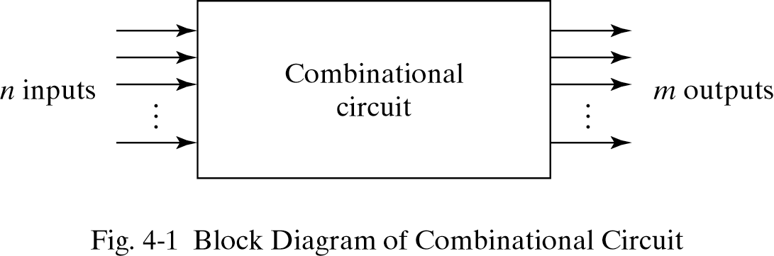
4.2 Combinational circuits
Outputs are determined from the present inputs
Consist of input/output variables and logic gates

Slide 3
4.3 Analysis procedure
To determine the function of circuit
Analysis procedure
  Make sure the circuit is combinational or sequential
  Obtain the output Boolean functions or the truth table

Slide 4
Analysis procedure
Boolean function
  Label all gate outputs
  Make output functions at each level
  Substitute final outputs to input variables
Truth table
  Put the input variables to binary numbers
  Determine the output value at each gate
  Obtain truth table

Slide 5
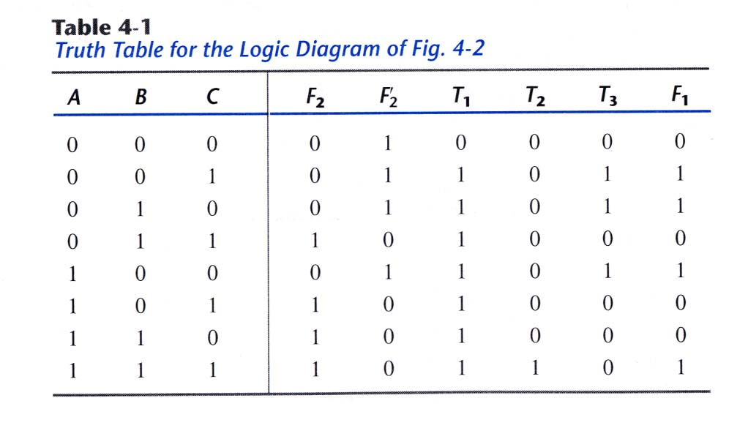
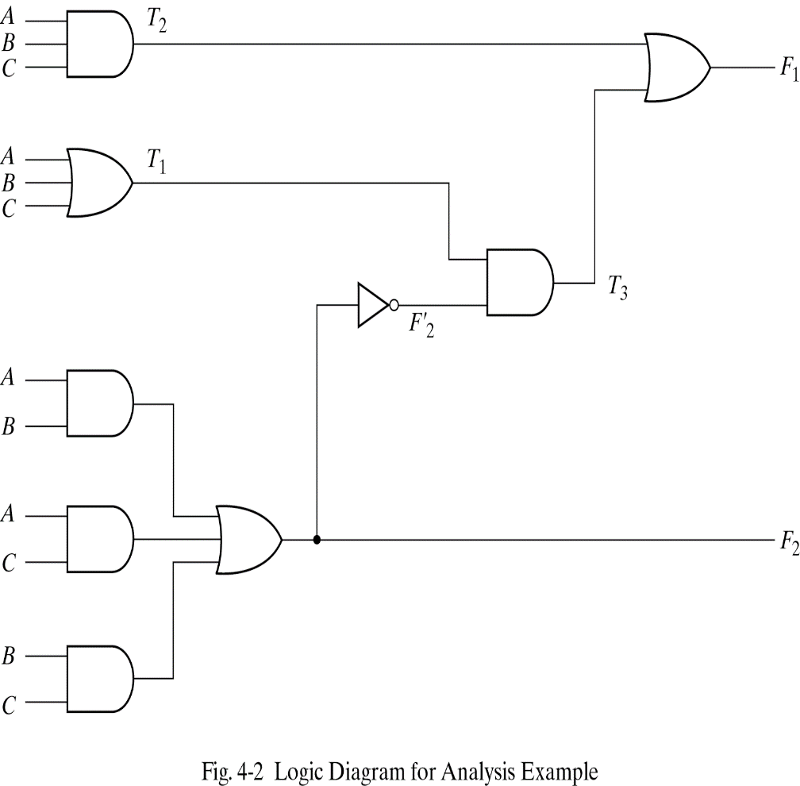
Analysis procedure

Slide 6
4.4 Design procedure
Procedure to design
  Determine the required number of input and output from specification
  Assign a letter symbol to each input/output
  Derive the truth table
  Obtain the simplified Boolean functions
  Draw the logic diagram and verify design correctness

Slide 7
Code conversion example
BCD to excess-3 code converter
  Excess-3 code : decimal digit+3
Design procedure
  1)Determine inputs/outputs
  Inputs : A,B,C,D (0000∼1001)
  Outputs : W,X,Y,Z (0011∼1100)

Slide 8
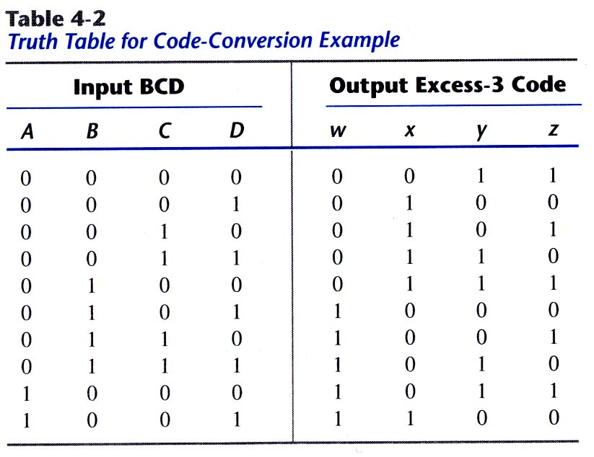
Code converter example
2)Derive truth table

Slide 9
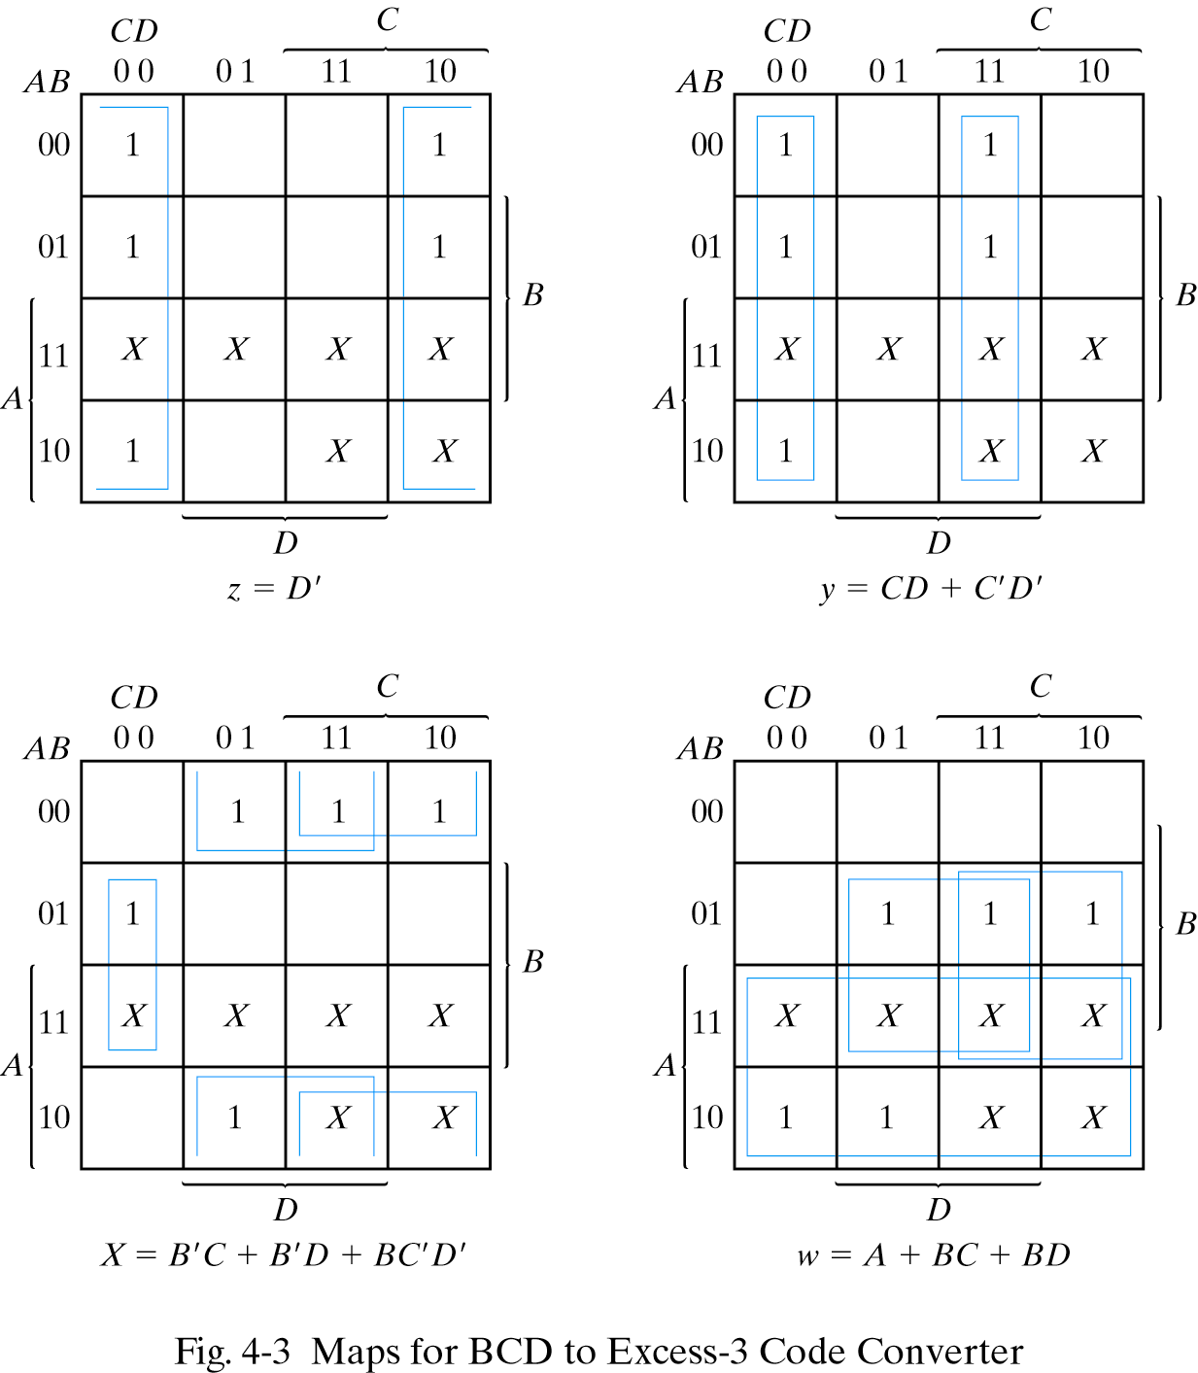
Code converter example
3)Obtain simplified Boolean functions

Slide 10
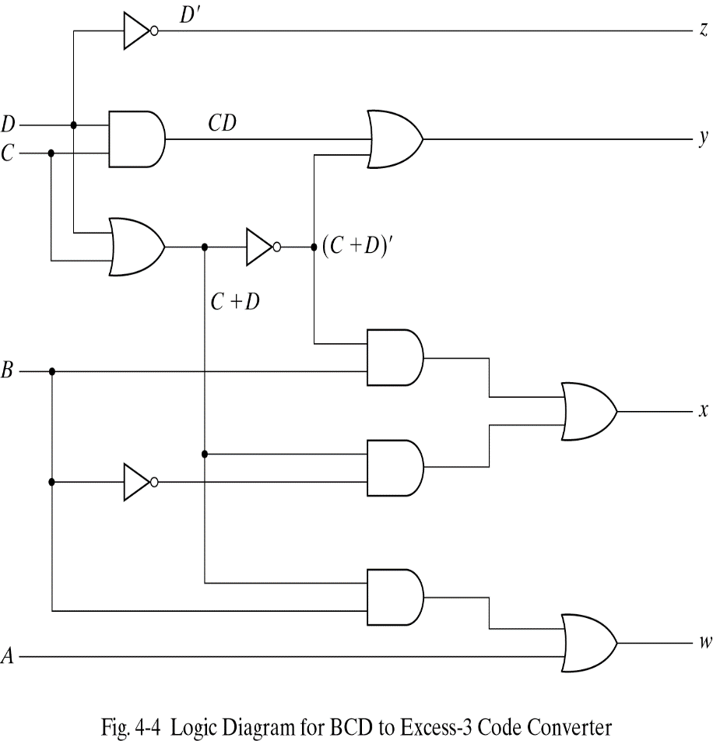
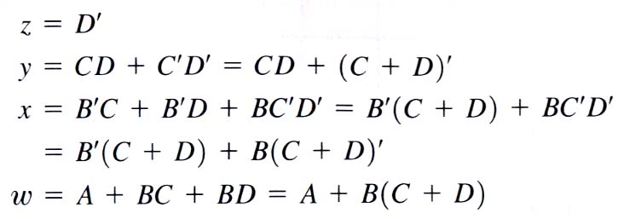
Code converter example
4)Draw the logic diagram

Slide 11
4.5 Binary adder-subtractor
Binary adder
  Half adder : performs the addition of 2-bits(x+y)
  Full adder : performs the addition of 3-bits(x+y
  +z)
  Two half adder can be employed to a full adder
Realization of Binary adder-subtractor
  Half adder
  Full adder
  Cascade of n-full adder
  Providing a complementing circuit

Slide 12
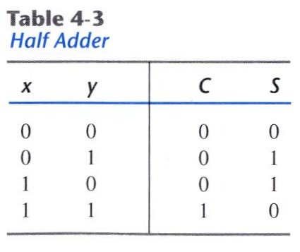
Half Adder
Sum of 2 binary inputs
Input : X(augend), Y(addend)
Output : S(sum), C(carry)
  S=xy′+x′y
  C=xy

Slide 13
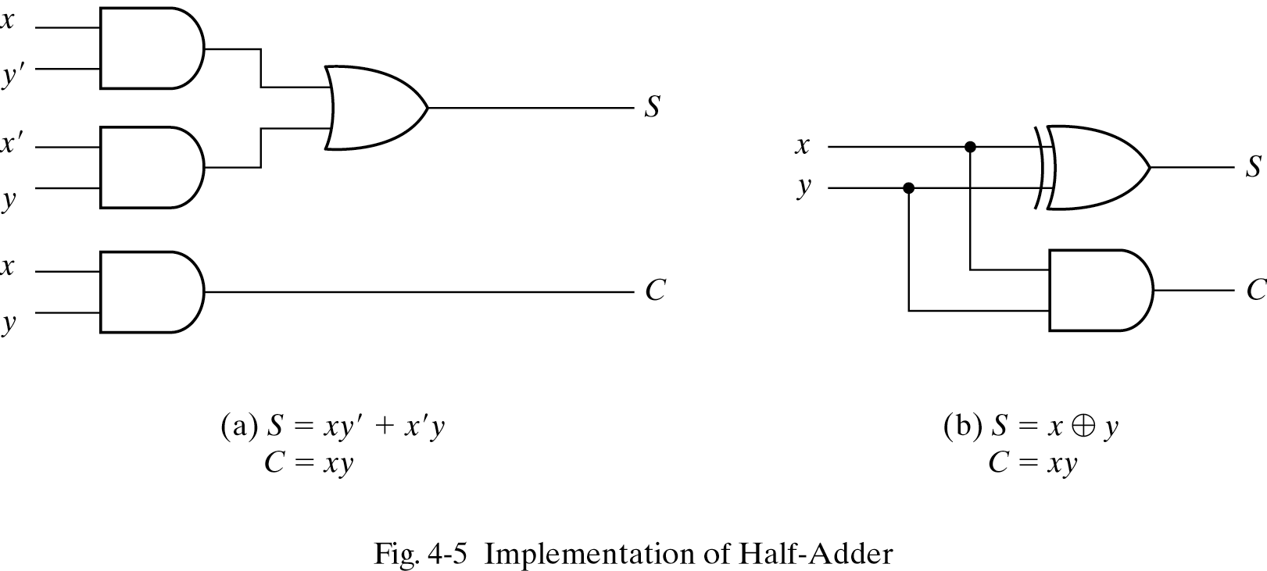
Half adder
-gate수가 적을수록 이득 무조건 게이트 수를 적게 만들어야 함
*

Slide 14
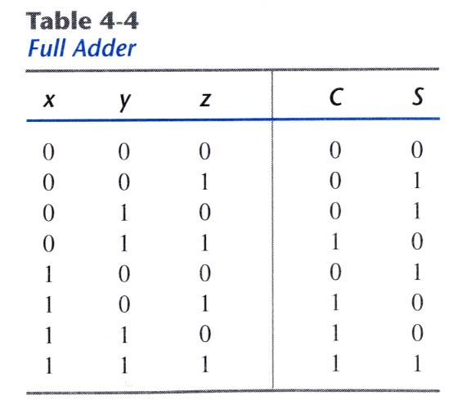
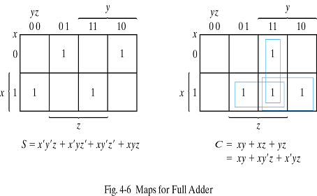
Full adder
Sum of 3 binary inputs
Input : X,Y(2 significant bits),Z(1 carry bit)
Output : S(sum),C(carry)

Slide 15
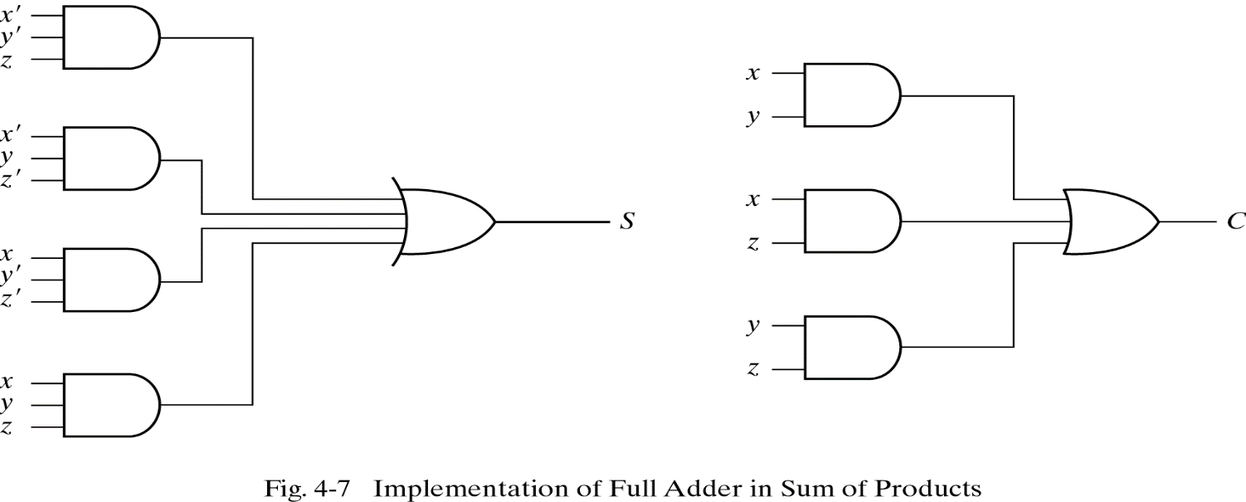
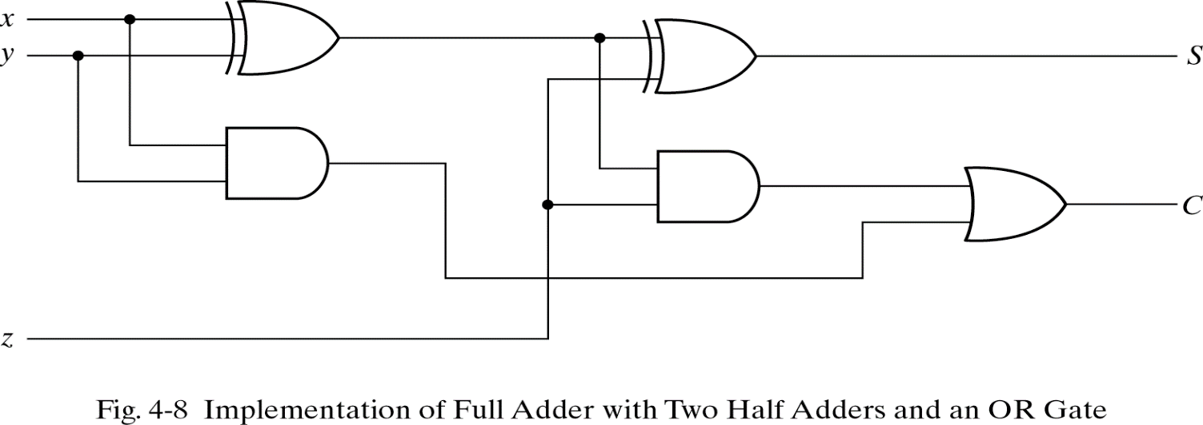
Full adder

Slide 16
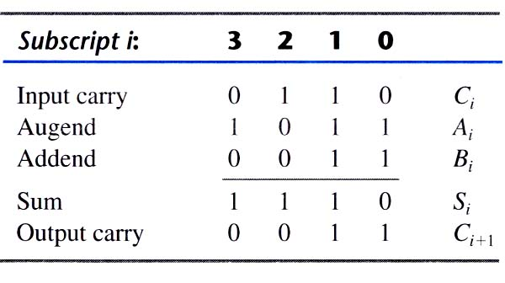
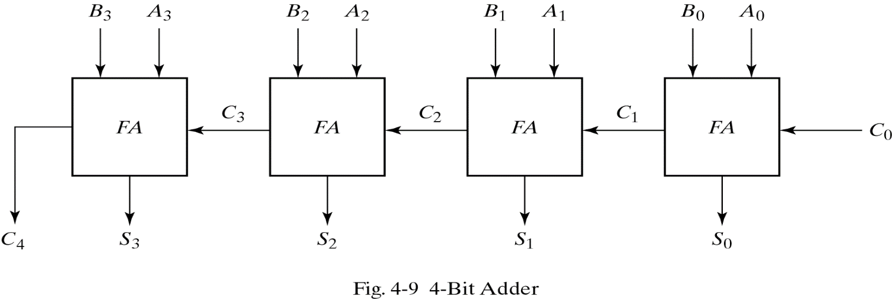
Binary adder
Sum of two n-bit binary numbers
  4-bit adder
  A=1011, B=0011

Slide 17
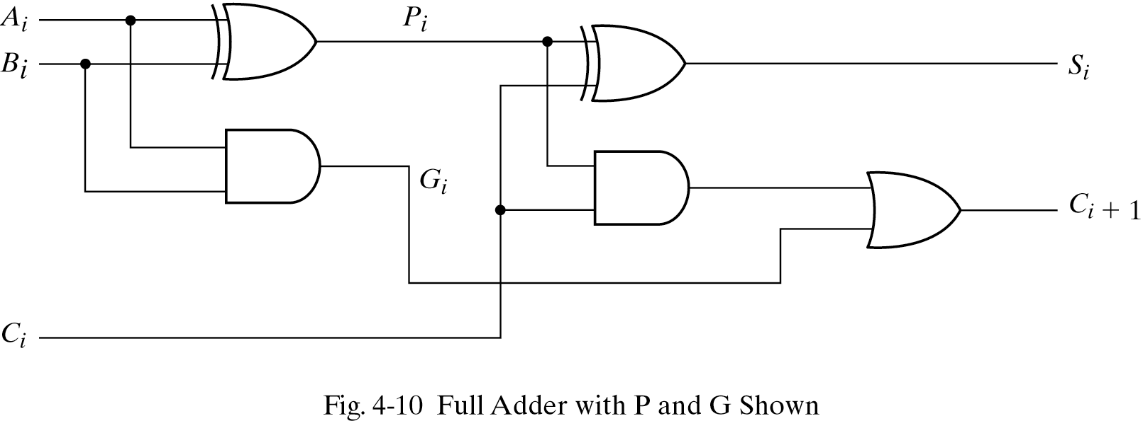
Carry propagation
Rising of delay time(carry delay)
One solution is carry lookahead
All carry is a function of Pi,Gi and C0

Slide 18
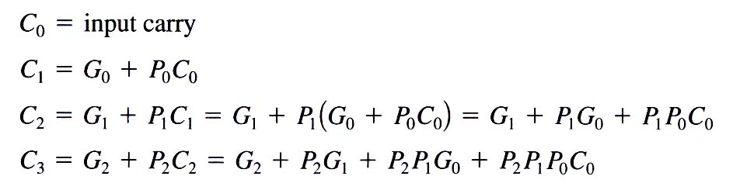
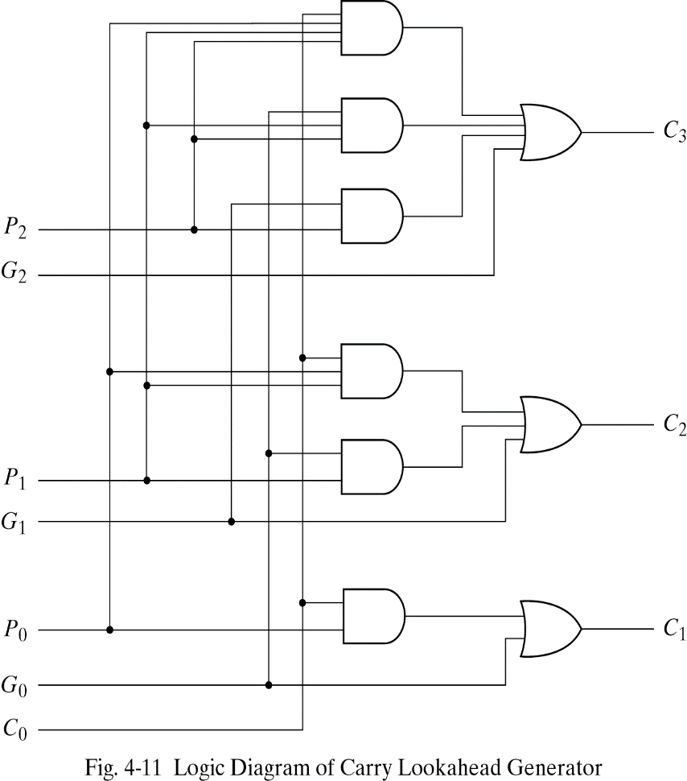
Carry propagation
Carry lookahead generator

Slide 19
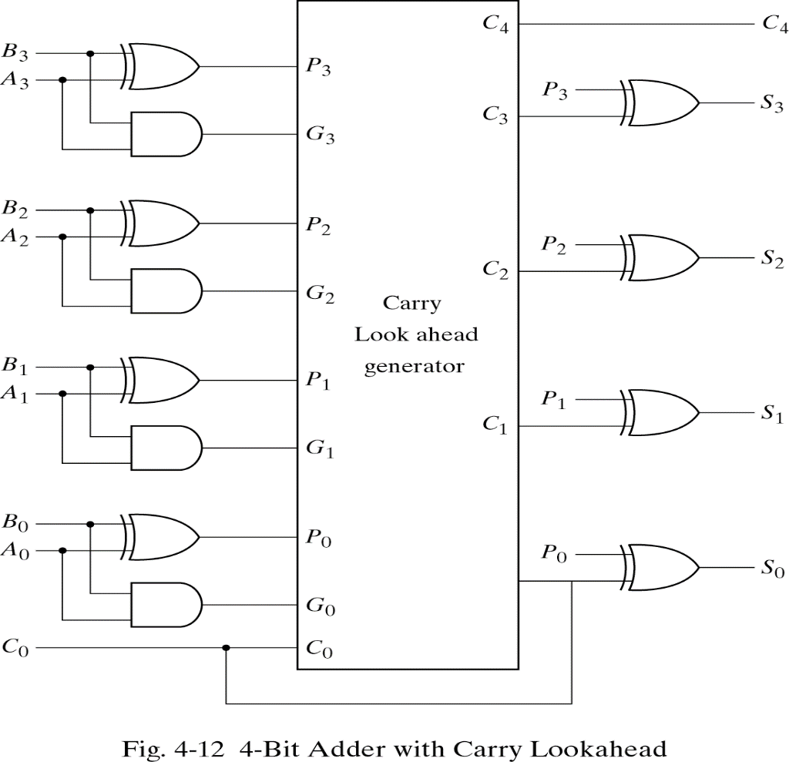
Carry propagation
4-bit adder with carry lookahead

Slide 20
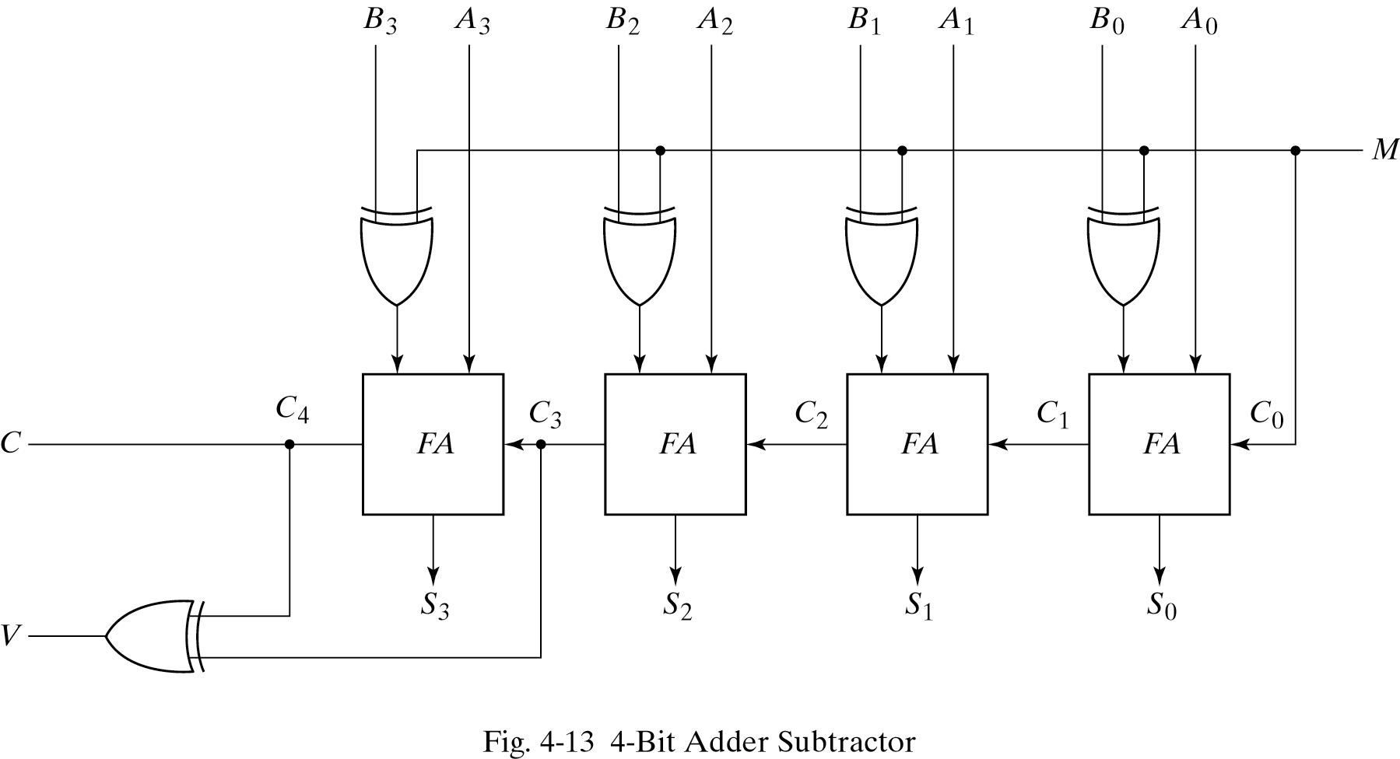
Binary subtractor
exclusive or 2의 보수를 만들어줌 full adder 4개니깐 여기에 exclusive or을 더해주면 뺄셈 기능이 가능하다.
A-B equals A+(2’complement of B)
When M=0(act as adder) M=1(subtractor)
*

Slide 21
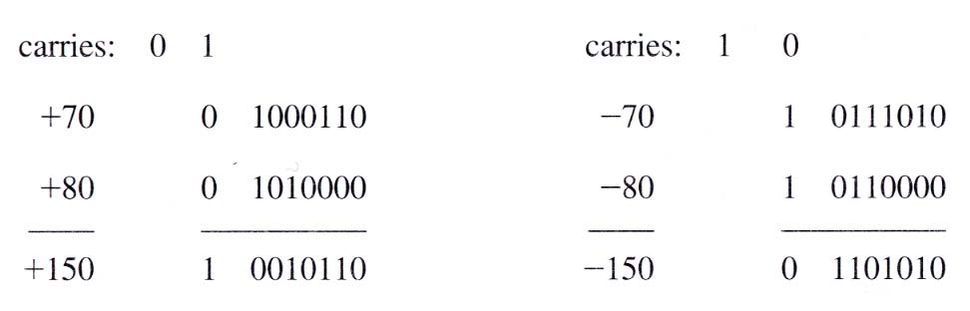
Overflow
Sum of n digit number occupies n+1digit
Occurs when two numbers are same sign
(examples of overflow)

Slide 22
4.6 Decimal adder
Calculate binary and represent decimal in binary coded form
Decimal adder for the BCD code

Slide 23
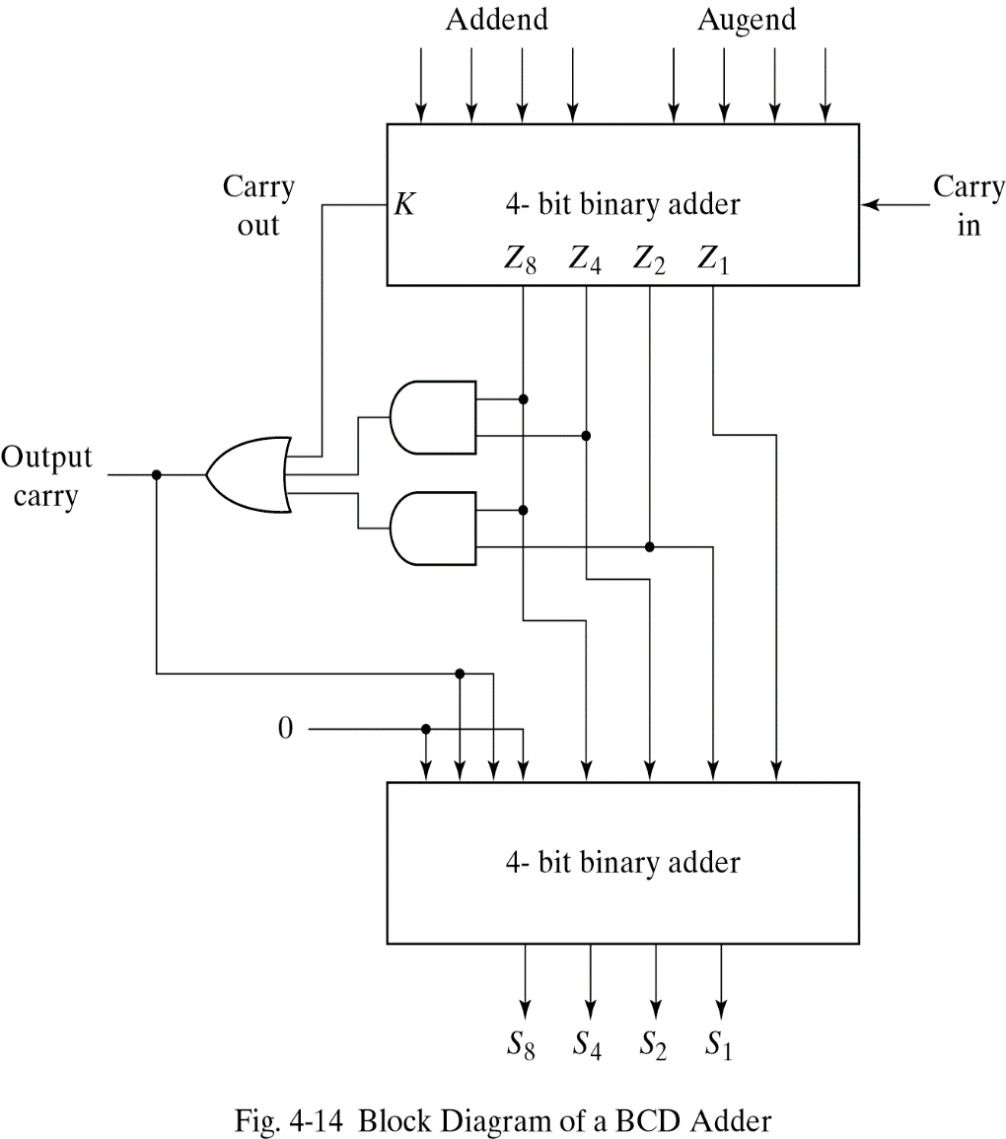
BCD Adder
BCD digit output of 2-BCD digit sum
Carry arise if output 1010~1111
C=K+Z8Z4+Z8Z2
1100
1101
1110
1111
1010
1011

Slide 24
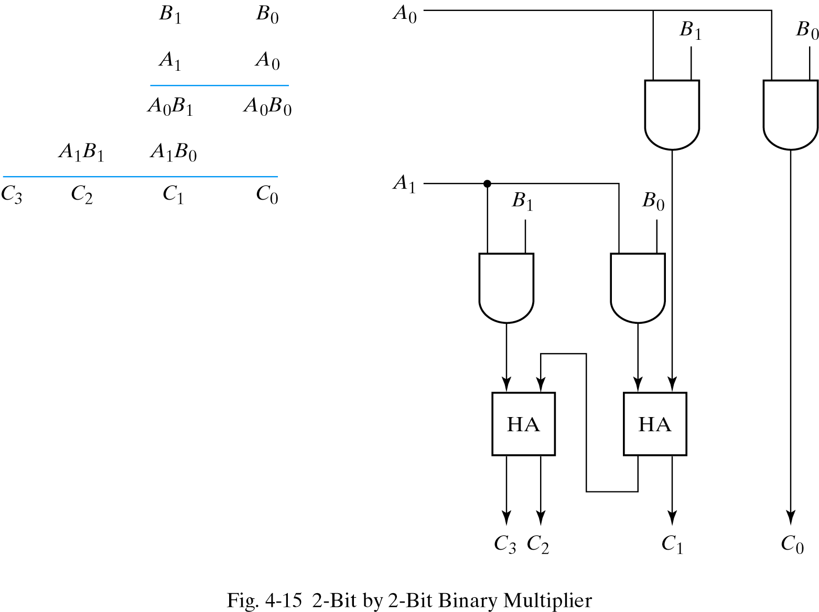
4.7 Binary multiplier
2bit x 2bit = 4bit(max)

Slide 25
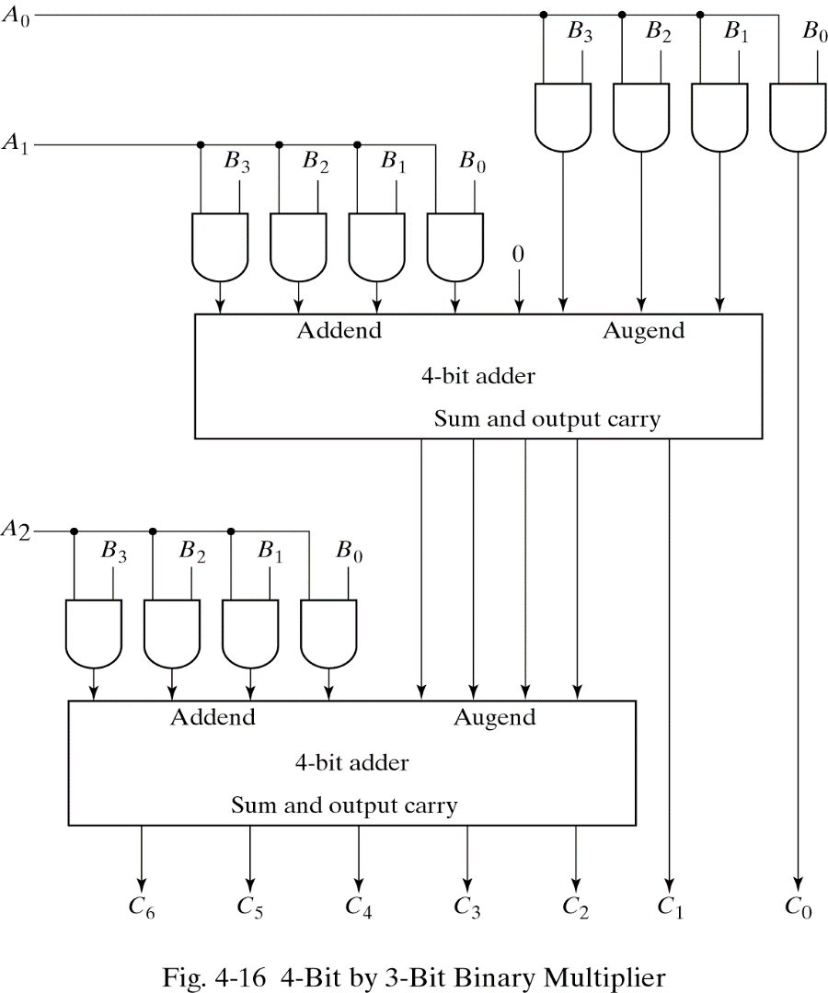
Binary multiplier
A0B1 이랑 A1B0
(K-bit) x (J-bit)
  (K x J) AND gates,
  (J-1) K-bit adder needed
  B3B2B1B0
  x A2A1A0
*

Slide 26
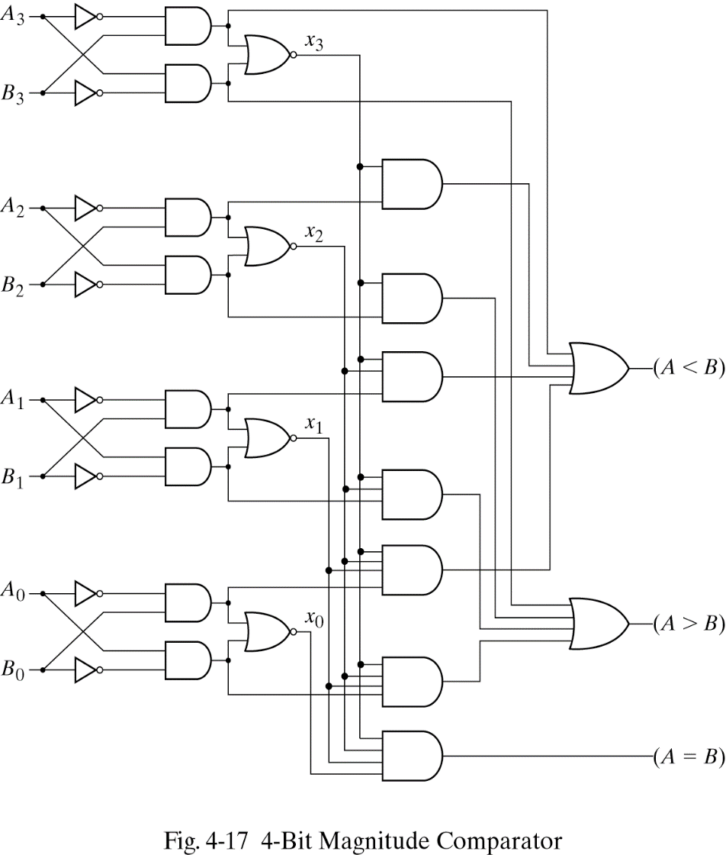
4.8 Magnitude comparator
Xi=1only if the pair of bits in i are equal
(A=B)=x3x2x1x0
(A>B)=A3B3′+x3A2B2′+x3x2A1B1′+x3x2x1A0B0′
(A<B)=A3′B3+x3A2′B2+x3x2A1′B1+x3x2x1A0′B0
*

Slide 27
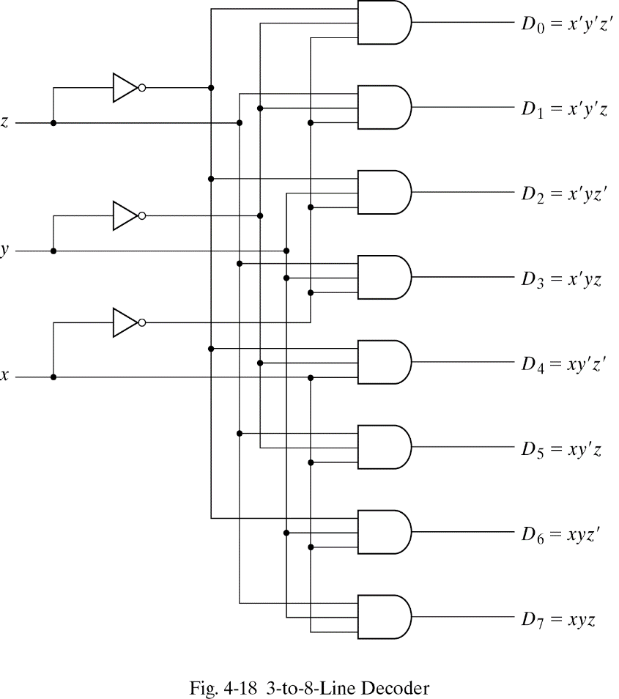
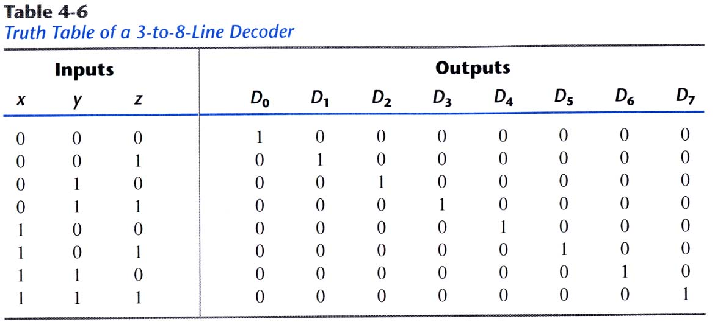
4.9 Decoders
Generate the 2ⁿ(or less) minterms of n input variables
  Eg)3 to 8 line decoder

Slide 28
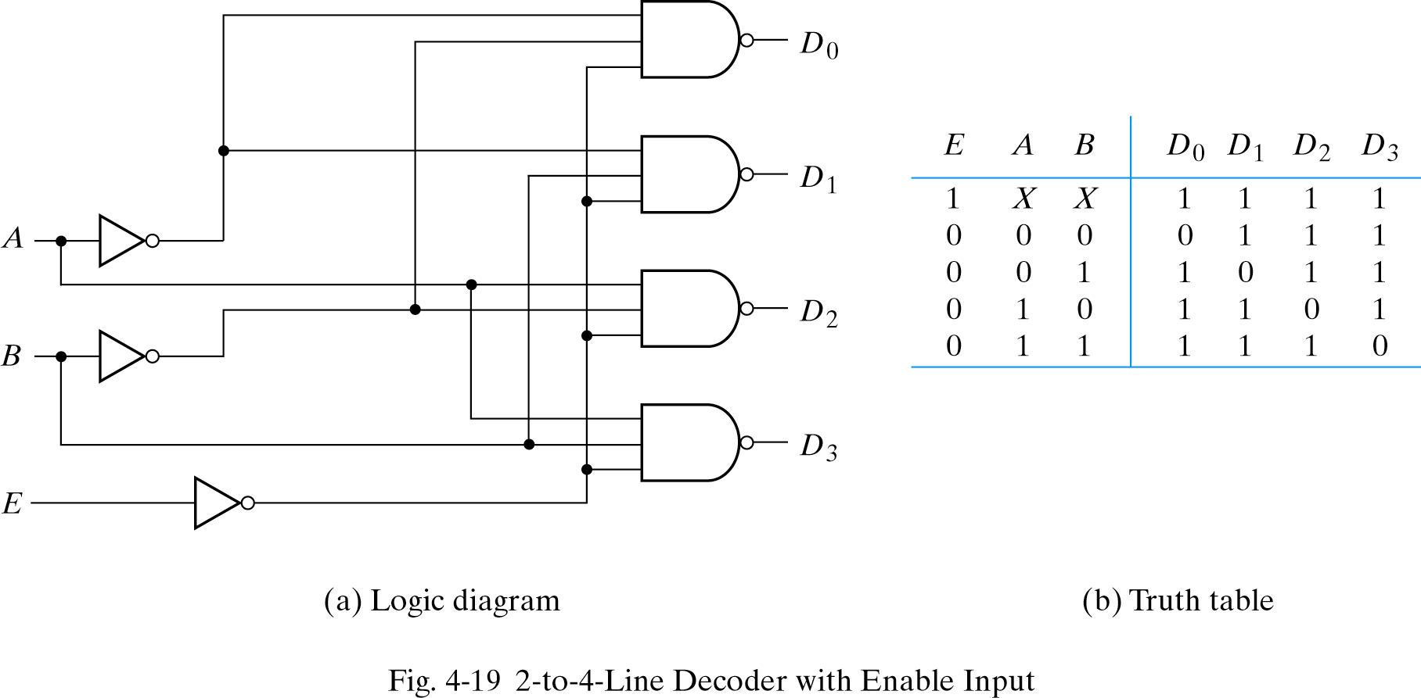
Decoders
2 to 4 line decoder with Enable input
  Control circuit operation by E
*

Slide 29
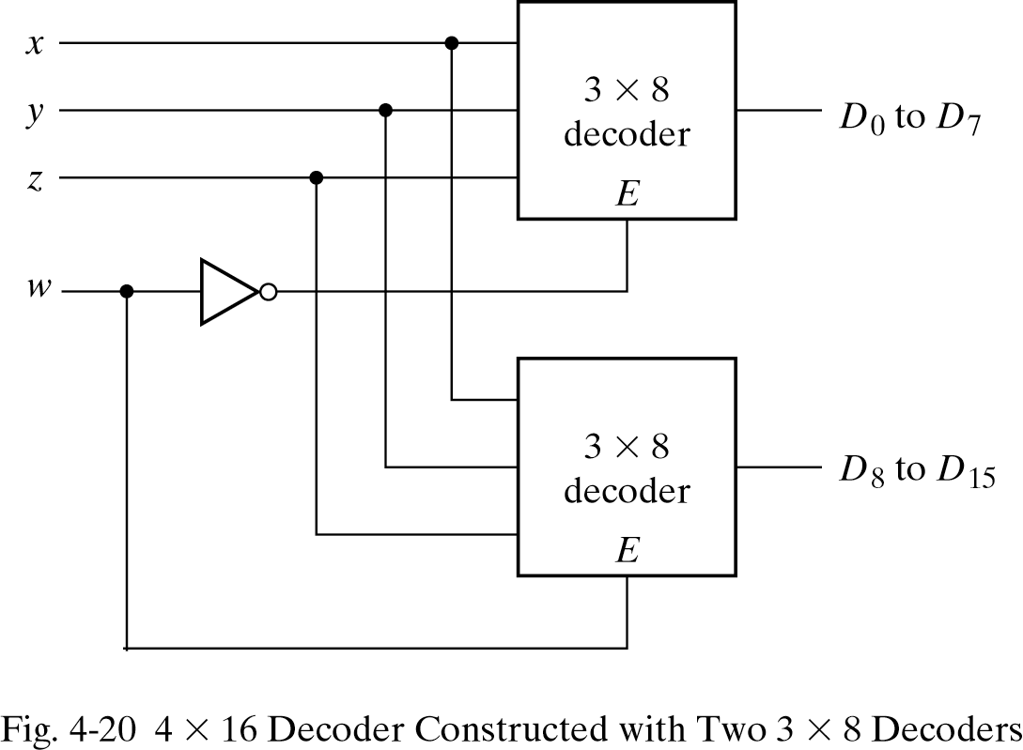
Decoders
Decoders with enable inputs can be a larger decoder circuit
Eg)4x16 decoder by two 3x8 decoders

Slide 30
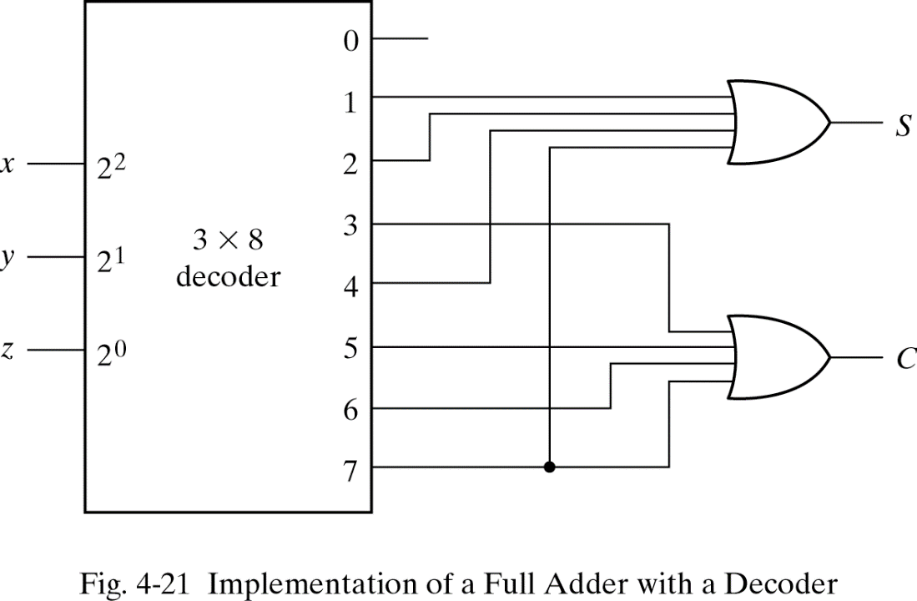
Decoders
Combinational logic implementation
  Any combinational circuit can be implemented with line decoder and OR gates
  Eg)full adder

Slide 31
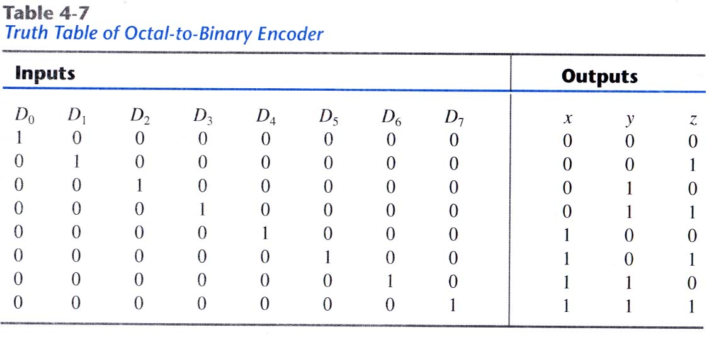
4.10 Encoders
Inverse operation of a decoder
Generate n outputs of 2ⁿ input values
  Eg) octal to binary encoder

Slide 32
4.11 Multiplexers
Select a binary information from many input lines
Selection is controlled by a set of selection lines
2ⁿ input lines have n selection lines

Slide 33
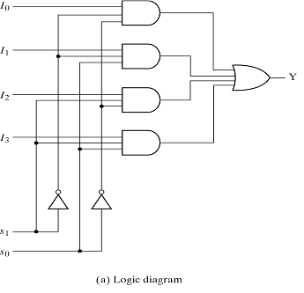
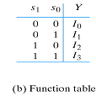
Multiplexers
4 to 1 line multiplexer

Slide 34
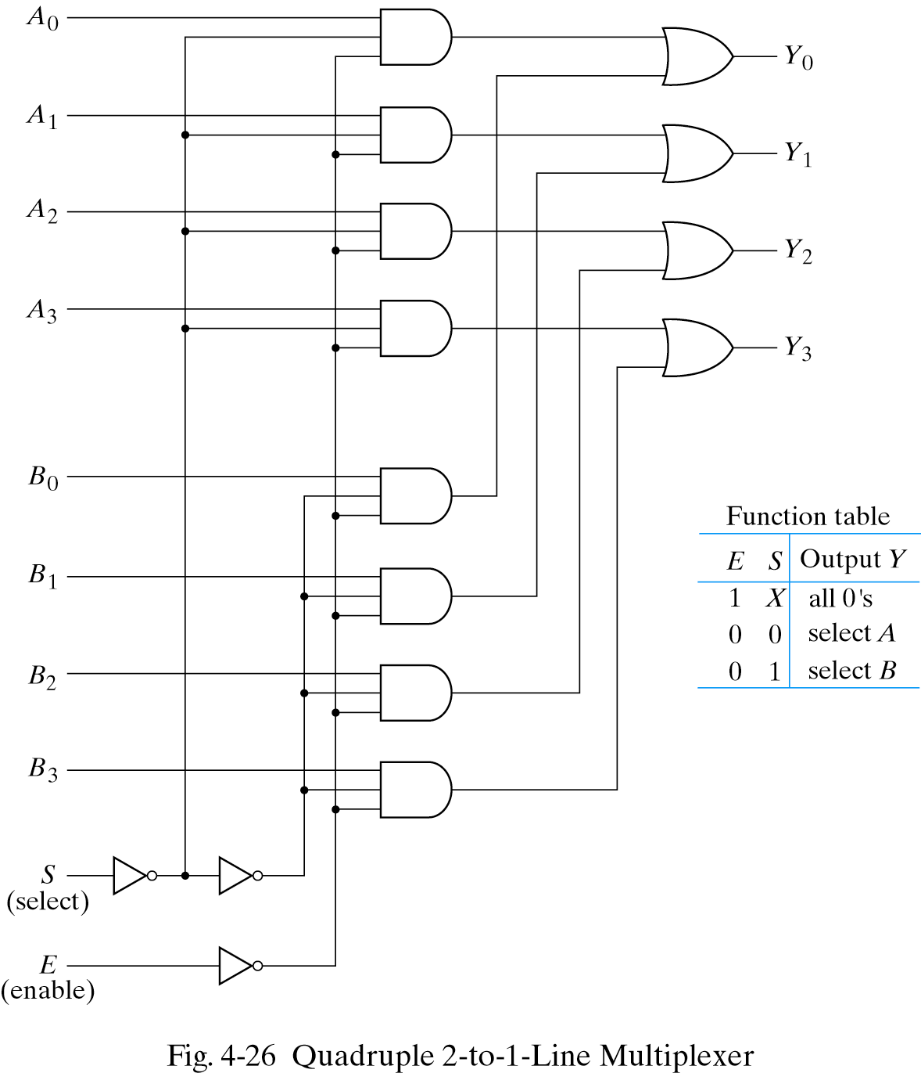
Multiplexers
Quadruple 2 to 1
line multiplexer

Slide 35
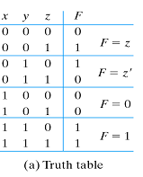
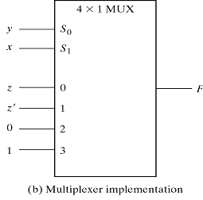
Multiplexers
Boolean function implementation
  Minterms of function are generated in a MUX
  n input variables, n-1 selection input
F=xy+yz′+x′y′z
*

Slide 36
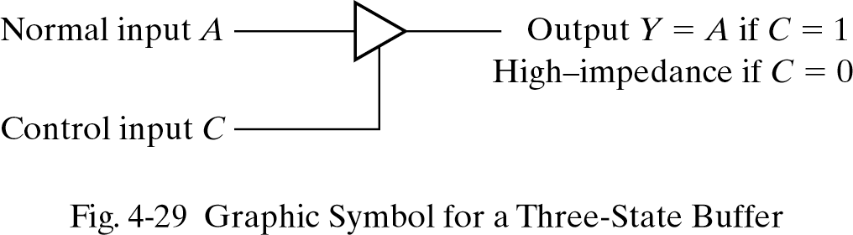
Multiplexers
Three-state gates
  Logic 1, 0 and high-impedance
  High-impedance behaves like an open circuit

Slide 37
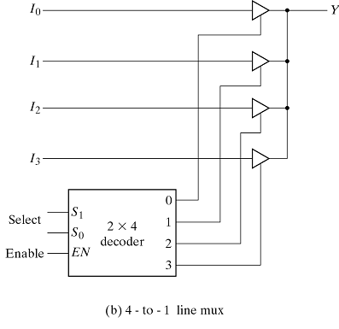
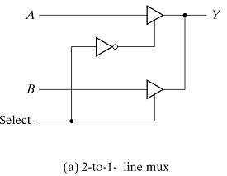
Multiplexers
Multiplexers with three-state gates

Slide 38
4.12 HDL for combinational circuit
Modeling techniques:
  Gate level modeling
    Instantiation of gates and user defined modules
  Dataflow modeling
    Using continuous assignment statements-assign
  Behavioral modeling
    Using procedural assignment statements-always

Slide 39
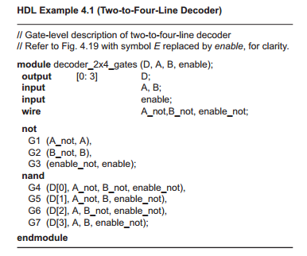
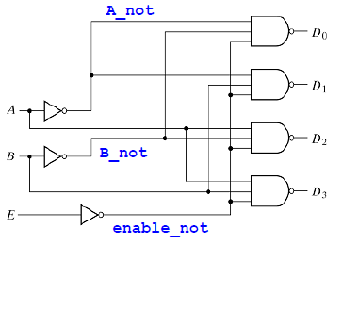
Gate-level modeling
Circuit is specified by its gates and their interconnection

Slide 40
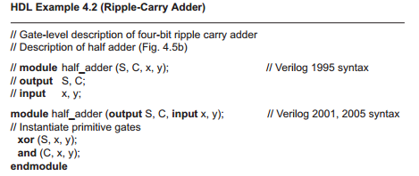
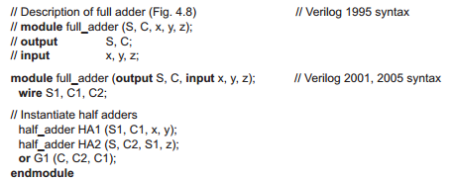
Instantiation

Slide 41
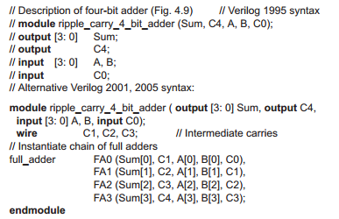
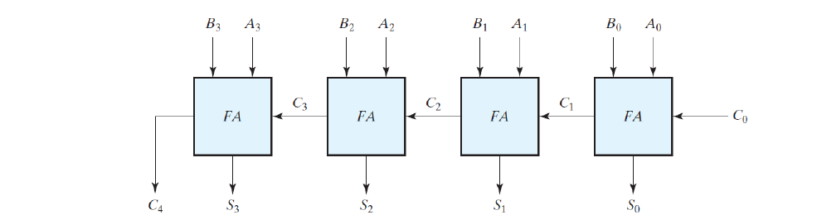
Instantiation in 4-bit adder
*

Slide 42
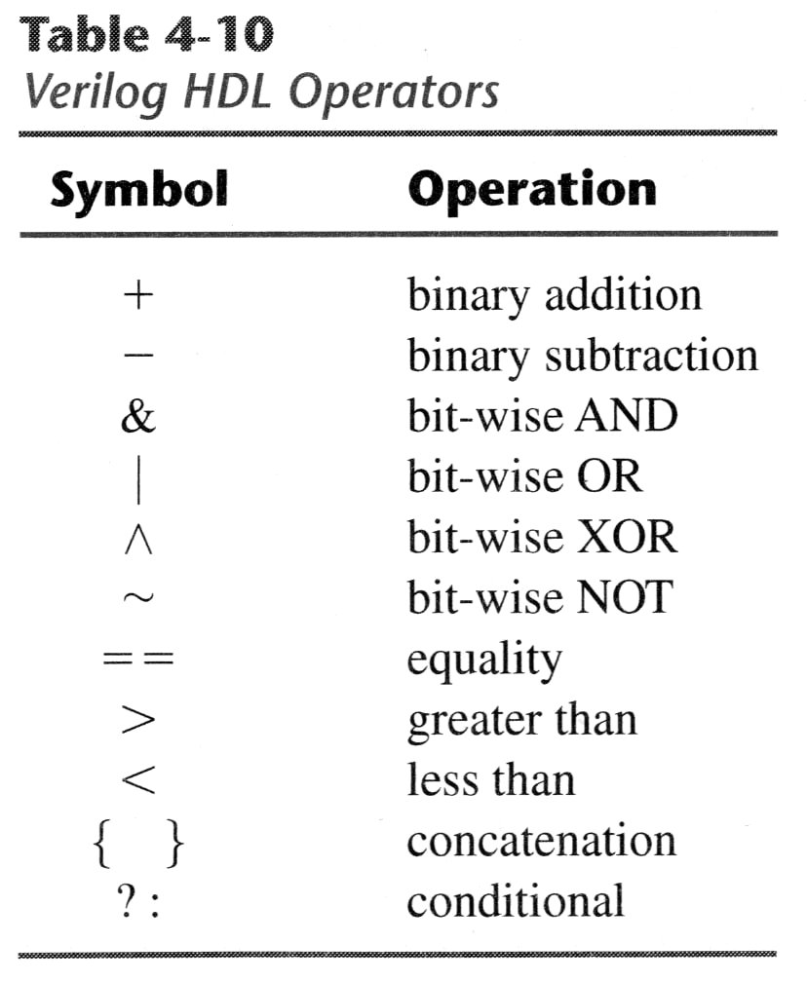
Dataflow modeling
Assign a value to a net by using operands and operators
eg)J=01,K=10 can be
{J,K}=0110
out=x ? A : B means
out=A, if x is true
=B, if x is false

Slide 43
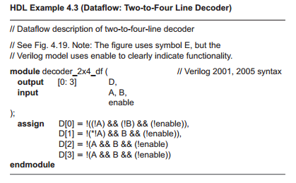
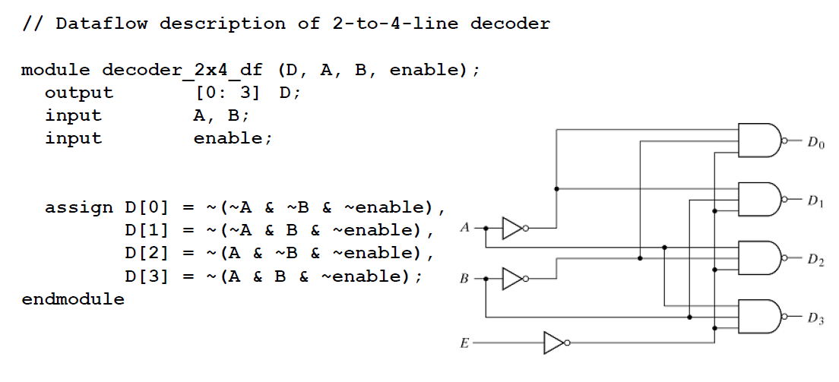
Assignment
- 2-to-4 line decoder

Slide 44
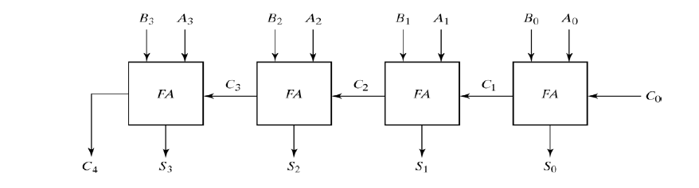
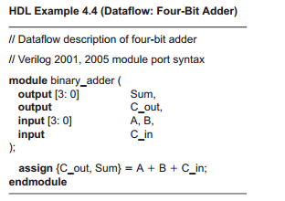
4-bit adder

Slide 45

Behavioral modeling
always문
항상 output은 always로 써준다
따로 공부해보자
Use procedural assignment statement,always
Target output must be the reg data type
Eg)4 to 1 line mux
*

Slide 46

Writing a simple test bench
Test bench : Applying stimulus to test HDL
and observe its response
reg - inputs , wire - outputs

Slide 47
System tasks
System tasks : keywords that can display various outputs (begin with $)
$display , $write , $monitor , $time , $finish
Format of system tasks
  Task name(format specification,argument list);
  Eg) $monitor(%d %b %b, C,A,B);

Slide 48


Example of test bench

